Slide 1
Hardware Architecture for High-Performance Regular Expression Matching
Author: Tsern-Huei Lee
Publisher: 2009 IEEE Transation on Computers
Presenter: Yuen-Shuo Li
Date: 2013/09/18

Slide 2
background
Deep packet inspection is an important component in network security appliances.
The function of deep packet inspection is to search for predefined patterns in packet payloads. It is very time consuming especially when patterns are specified with regular expressions.
According to some report [3], the pattern matching module can consume up to 70 percent of CPU computation power in an intrusion detection system. As a consequence, pure software-based pattern matching is not suitable for high-speed networks.
[3] Deterministic Memory-Efficient String Matching Algorithms for Intrusion Detection
Notes:
說 DPI 很重要，而其搜尋是用 RE 做的，然後需要很好的效能
這篇是想在硬體上做，所以說了純軟體的壞話

Slide 3
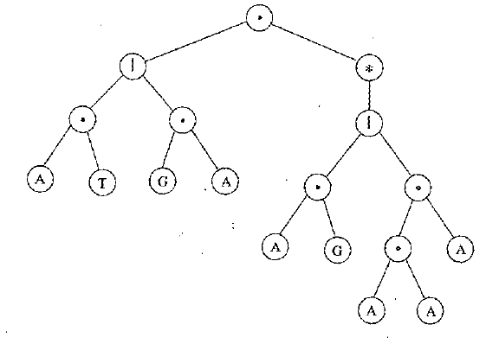
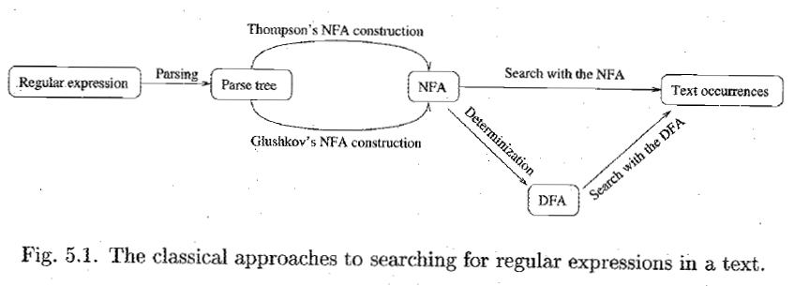
background
Notes:
處理 Regular Expression 時，通常會先經過幾個步驟：建成 Parse Tree 後，再建成 NFA，而 NFA 又可以轉成等價的 DFA
搜尋時，可以使用直接使用 NFA 或轉成 DFA 再處理。
NFA 的缺點是搜尋速度較慢，而 DFA的缺點是所需要記憶體較多

Slide 4
introduction
In this paper, we present a different approach to implement an NFA.
Our implementation is for the Glushkov NFA (G-NFA). We show that the implementation can handle special symbols commonly used in extended regular expressions.
To achieve high performance, we generalize the implementation so that multiple symbols are processed in an operation cycle.
Notes:
這是一個使用 NFA 的方法
使用 Glulshkov 的方式實作
為了增加效能，可以一次讀多個字元

Slide 5
Shift-OR approach
Let T[x] be a table about pattern such that:
$$T_{i}\left[x\right]=\left\{\begin{aligned}0 \\ 1\end{aligned}{x={pattern}_{i} \atop otherwise}\right.$$
e.g. Let {a, b, c, d} be the alphabet, and ababc the pattern.
T[a] = 11010
T[b] = 10101
T[c] = 01111
T[d] = 11111
cbaba
T[a] = 11010
Notes:
這篇的目的是希望結合 Shift-Or Alg 和 Glushkov 兩個方法，讓 Shift-Or alg 可以支援 FA。
可是這篇把 Shift-Or 當常識了，所以我補充一下 shift-or 的方法

Slide 6
Shift-OR approach
The initial state is 11111
State
1 | 1 | 1 | 1 | 1
a | b | d | a | b | a | b | a | b | c
text
T[a] = 11010
T[b] = 10101
T[c] = 01111
T[d] = 11111

Slide 7
Shift-OR approach
The initial state is 11111
State
1 | 1 | 1 | 1 | 1
a | b | d | a | b | a | b | a | b | c
text
T[a] = 11010
T[b] = 10101
T[c] = 01111
T[d] = 11111

Slide 8
Shift-OR approach
The initial state is 11111
State
1 | 1 | 1 | 1
a | b | d | a | b | a | b | a | b | c
text
T[a] = 11010
T[b] = 10101
T[c] = 01111
T[d] = 11111

Slide 9
Shift-OR approach
The initial state is 11111
1 1 0 1 0
State
1 | 1 | 1 | 1 | 0
a | b | d | a | b | a | b | a | b | c
text
T[a] = 11010
T[b] = 10101
T[c] = 01111
T[d] = 11111

Slide 10
Shift-OR approach
The initial state is 11111
State
1 | 1 | 1 | 0 | 1
a | b | d | a | b | a | b | a | b | c
text
T[a] = 11010
T[b] = 10101
T[c] = 01111
T[d] = 11111

Slide 11
Shift-OR approach
The initial state is 11111
State
1 | 1 | 1 | 1 | 1
a | b | d | a | b | a | b | a | b | c
text
T[a] = 11010
T[b] = 10101
T[c] = 01111
T[d] = 11111

Slide 12
Shift-OR approach
The initial state is 11111
State
1 | 1 | 1 | 1 | 0
a | b | d | a | b | a | b | a | b | c
text
T[a] = 11010
T[b] = 10101
T[c] = 01111
T[d] = 11111

Slide 13
Shift-OR approach
The initial state is 11111
State
1 | 1 | 1 | 0 | 1
a | b | d | a | b | a | b | a | b | c
text
T[a] = 11010
T[b] = 10101
T[c] = 01111
T[d] = 11111

Slide 14
Shift-OR approach
The initial state is 11111
State
1 | 1 | 0 | 1 | 0
a | b | d | a | b | a | b | a | b | c
text
T[a] = 11010
T[b] = 10101
T[c] = 01111
T[d] = 11111

Slide 15
Shift-OR approach
The initial state is 11111
State
1 | 0 | 1 | 0 | 1
a | b | d | a | b | a | b | a | b | c
text
T[a] = 11010
T[b] = 10101
T[c] = 01111
T[d] = 11111

Slide 16
Shift-OR approach
The initial state is 11111
State
1 | 1 | 0 | 1 | 0
a | b | d | a | b | a | b | a | b | c
text
T[a] = 11010
T[b] = 10101
T[c] = 01111
T[d] = 11111

Slide 17
Shift-OR approach
The initial state is 11111
State
1 | 0 | 1 | 0 | 1
a | b | d | a | b | a | b | a | b | c
text
T[a] = 11010
T[b] = 10101
T[c] = 01111
T[d] = 11111

Slide 18
Shift-OR approach
The initial state is 11111
The match at the end of the text is indicated by the value 0 in the leftmost bit of the state
State
0 | 1 | 1 | 1 | 1
a | b | d | a | b | a | b | a | b | c
text
T[a] = 11010
T[b] = 10101
T[c] = 01111
T[d] = 11111

Slide 19
Shift-OR approach
The complexity of the search time in the worst and average case is $O\left(\left\lceil \frac{mb}{w}\right\rceil n\right)$, where $\left\lceil \frac{mb}{w}\right\rceil$ is the time to compute a constant of operations on integers of mb bits using a word size of w bits.
m: pattern size
w: word size

Slide 20
Shift-OR approach
S => T
R=> State
100101 => 010010
110011 OR
110011
Notes:
剛剛是幫忙複習，但這篇的視角是左右相反
這裡 R 對應 State，S 對應 T

Slide 21
Glushkov-nfa
We state some well-known properties of the G-NFA.
$$ε$$
1.
2.
A₁
≡
A
Notes:
因為不知道怎麼用數學符號讓人理解，所以用畫的

Slide 22
Glushkov-nfa
Let $Σ$ denote the alphabet and consider a regular expression RE that consists of N symbols in $Σ$.
Let L(RE) represent the language defined by RE.
To construct the G-NFA that recognizes all strings belonging to L(RE).

Slide 23
Glushkov-nfa
The positions of the symbols in RE are marked, counting only symbols and denote the marked expression by $\hat{RE}$ and let L($\hat{RE}$) represent its language.
Let Pos($\hat{RE}$) be the set of positions in $\hat{RE}$ and $\hat{Σ}$ the marked symbol alphabet.
$$RE=\left(AB | CA\right){\left(ADB | CEF\right)}^{∗}$$
$$\hat{RE}=\left(A1B2 | C3A4\right){\left(A5D6B7 | C8E9F10\right)}^{∗}$$
L($\hat{RE)}=\{A1B2, C3A4, A1B2A5D6B7$…}
$$Pos\left(\hat{RE}\right)=\left\{1, 2, 3,…,N\right\} if RE consists of N symbols$$

Slide 24
Glushkov-nfa
The G-NFA is first built for the marked expression $\hat{RE}$ and then for RE by erasing the position indices of all the symbols.
Notes:
先在有 Label 的形式建 NFA ，再轉成沒有 Label 的形式。
Label 的 NFA 和 沒有 Label 的 NFA 是可以直接對應的。

Slide 25
Glushkov-nfa
$σ$_{k} represents the indexed symbol of $\hat{RE}$ at position k and ${\hat{Σ}}^{∗}$ denotes the set of all strings of symbols in $\hat{Σ}$.
Def 1. $First\left(\hat{RE}\right)=\{x∈Pos\left(\hat{RE}\right),∃u∈{\hat{Σ}}^{∗},σ_{x}u∈L\left(\hat{RE}\right)\}$
Def 2. $Last\left(\hat{RE}\right)=\{x∈Pos\left(\hat{RE}\right),∃u∈{\hat{Σ}}^{∗},uσ_{x}∈L\left(\hat{RE}\right)\}$
Def 3. $Follow\left(\hat{RE}\right)=\{x∈Pos\left(\hat{RE}\right),∃u∈{\hat{Σ}}^{∗},uσ_{x}∈L\left(\hat{RE}\right)\}$
e.g. $\hat{RE}=\left(AB | CA\right){\left(ADB | CEF\right)}^{∗}$ => First($\hat{RE}$) = {1, 3}
e.g. $\hat{RE}=\left(AB | CA\right){\left(ADB | CEF\right)}^{∗}$ => Last($\hat{RE}$) = {2, 4, 7, 10}

Slide 26
Glushkov-nfa
One can easily construct $M_{\hat{RE}}$ as long as $First\left(\hat{RE}\right)$, $Last\left(\hat{RE}\right)$, and $Follow\left(\hat{RE}\right)$ are known.
$\hat{RE}=\left(AB | CA\right){\left(ADB | CEF\right)}^{∗}$
=> First($\hat{RE}$) = {1, 3}
=> Last($\hat{RE}$) = {2, 4, 7, 10}
Notes:
建立的方法這個 Paper 沒有實際提到，不過我有在後面補充，簡單來說，建立的方式是依據 First, Last, and Follow 這三個函式建成的。
然後之後會證明說使用 First 、Last 、Follow 確實可以建立 RE

Slide 27
Glushkov-nfa
$\overline{RE}={RE}_{1}|{RE}_{2}:$ $First\left(\overline{RE}\right)=First\left({RE}_{1}\right)∪First\left({RE}_{2}\right);$ $Last\left(\overline{RE}\right)=Last\left({RE}_{1}\right)∪Last\left({RE}_{2}\right);$ $Follow\left(\overline{RE}, x\right)=Follow\left({RE}_{1},x\right) if x ε Pos\left({RE}_{1}\right) or$ $Follow\left({RE}_{2}\right) ifx ε Pos\left({RE}_{2}\right)$

Slide 28
Glushkov-nfa
$\overline{RE}={RE}_{1}∙{RE}_{2}:$ $First\left(\overline{RE}\right)=First\left({RE}_{1}\right)∪First\left({RE}_{2}\right) if ε ε L\left({RE}_{1}\right) or First\left({RE}_{1}\right) otherwise;$
$$Last\left(\overline{RE}\right)= Last\left({RE}_{1}\right)∪Last\left({RE}_{2}\right) ifε ε L\left({RE}_{2}\right) or Last\left({RE}_{2}\right) otherwise$$
Follow
Notes:
本來想要用打的，不過數學符號太麻煩了，所以放棄了。

Slide 29
Glushkov-nfa
$\overline{RE}={RE}^{∗}:$ $First\left(\overline{RE}\right)=First\left(RE\right);$ $Last\left(\overline{RE}\right)=Last(RE)$

Slide 30
Glushkov-nfa

Slide 31
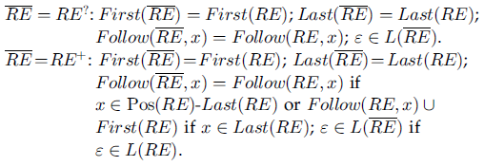
Glushkov-nfa
A? = (A|$ε$)
A⁺ = AA*
Notes:
延伸的部分可能會看到頭暈眼花，不過其實只要知道這些延伸的部分都是由三個最基本的符號組成的

Slide 32
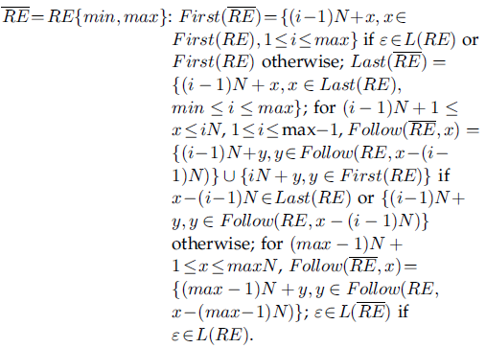
Glushkov-nfa
A{1,3} = A(A|$ε$) (A|$ε$)

Slide 33
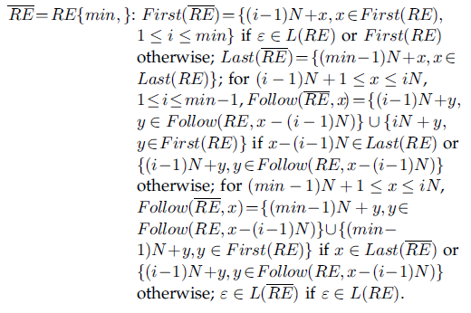
Glushkov-nfa
A{1,3} = A(A|$ε$) (A|$ε$)

Slide 34
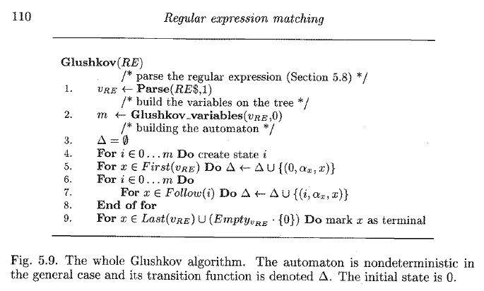
Glushkov-nfa
Notes:
這是從一本書節錄來的內容，大概講述如何由 First, Follow, Last 建立 NFA

Slide 35
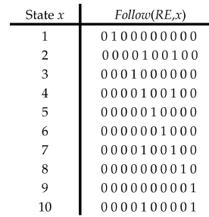
A bitmap-based architecture
The symbol ~, which appears in the Enter($α$) table, means any symbol other than A, B, C, D, E, and F.
Notes:
所有可行的下一個 state，從 State 1 開始數
輸入 2 進的下一個 State 有 state5, state8

Slide 36
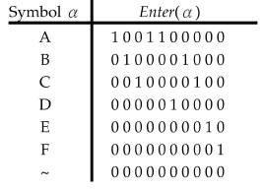
A bitmap-based architecture
Let $Enter\left(α\right)=\bigcup_{xεS}{δ(x, α)}$.
The symbol ~, which appears in the Enter($α$) table, means any symbol other than A, B, C, D, E, and F.
Notes:
所有可行的下一個 state，從 State 1 開始數
輸入 A 能進的 State 有 State1, State4, State5

Slide 37
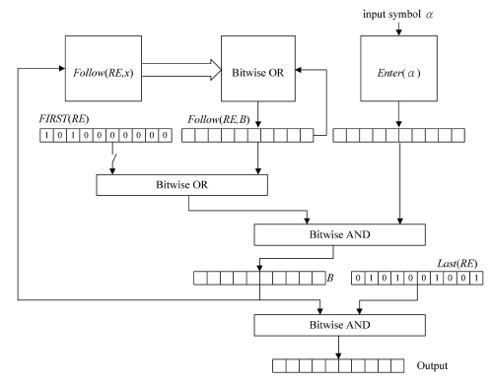
A bitmap-based architecture
First(RE) = 1010000000
and
Enter(A) = 1001100000
State 1 =>
1000000000
Follow(RE, 1) = 0100000000
and
Enter(B) = 0100001000
0100000000
B : the set of active states.
Notes:
查看是不是 x 的下一個 State，從 State 1 開始數
左上角的迴圈是將所有的 active state OR 起來再和下一個可行的 State AND 起來
左上角的迴圈是可能不只有一個 Active State
其實比較像是 Shift And

Slide 38
A bitmap-based architecture
We examine the Output register after the last symbol of input string T is processed. The input string T is accepted iff the final content of Output register is not zero.

Slide 39
A bitmap-based architecture
Note that the Follow(RE, x) table may have to be accessed up to N times if all bits of B are 1’s.
It is possible to reduce this number by precomputation.
To further improve system performance, the four groups can be stored in separate memories and fetched simultaneously.
The trade-off is an increase of memory requirement by many times.
Notes:
就是指那個迴圈預先算好，雖然可以省去迴圈的動作，但卻會多花費很多 memory

Slide 40
A High-performance bitmap-based architecture
We generalize the architecture so that K(>=2) symbols are processed in each operation cycle.
Different from M_{RE}, the current state is not sufficient for $M_{RE}^{d}$ to decide whether or not a substring of T.
Instead, we need to know the current state and the input d-symbol.
Note that it is possible to find multiple matches with current state x and input d-symbol u.
Notes:
如果想要 Generalize 成一次多個字元該如何做？
提了一個方法，但接下來一連串的證明說這個方法不可行，不過我們直接舉例說這個方法確實是不行的

Slide 41
A High-performance bitmap-based architecture
With K=4, we have :
Follow(RE, 0) = {0, 1, 2, 3, 4, 5, 6, 8}
Enter(EFAD) = {0, 6}
Follow(RE, 0) $∩$ Enter(EFAD) = {0, 6}
Wrong
Notes:
說明了要知道 input 前，還要知道目前的 Active State
(K, active state)

Slide 42
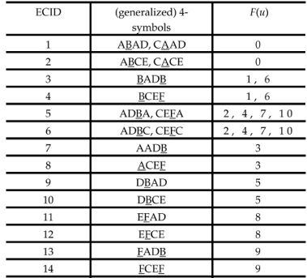
A High-performance bitmap-based architecture
F(u): xth bit is a 1 iff $\left(x, u\right)∈S_{4}^{′} × Σ^{4}$
Since the total number of possible K-symbols could be huge, it is important to define equivalence class for them.
For our propose, two K-symbols u and v are in the same equivalence class iff H(x, u) = H(x, v)
Notes:
有底線代表 accepted state

Slide 43
A High-performance bitmap-based architecture
u is in Group 1 iff it satisfies $δ_{4}\left(x, u\right)∩S≠∅ for some state x ϵ S$
F(u): xth bit is a 1 iff $\left(x, u\right)∈S_{4}^{′} × Σ^{4}$
Notes:
有底線代表 accepted state

Slide 44
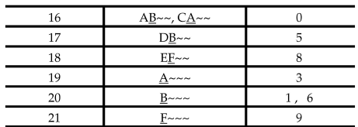
A High-performance bitmap-based architecture
Every generalized 4-symbol in Group 2 contains at least one ~ at the end.
Besides, for u in Group 1 and v in Group 2, we have $F\left(v\right)⊂F(u)$
~ represents any symbol.
The ECID of the equivalence class, which contains the most specific K-symbol, is selected if an input K-symbol matches multiple K-symbols in different equivalence classes.
Notes:
有底線代表 accepted state

Slide 45
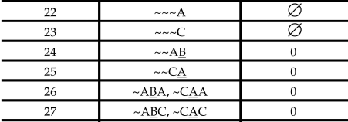
A High-performance bitmap-based architecture
The generalized 4-symbols in Group 3 contain at least one ~ at the beginning and are necessary for the states that can be accessed by state 0 in less than four steps.
Notes:
有底線代表 accepted state

Slide 46
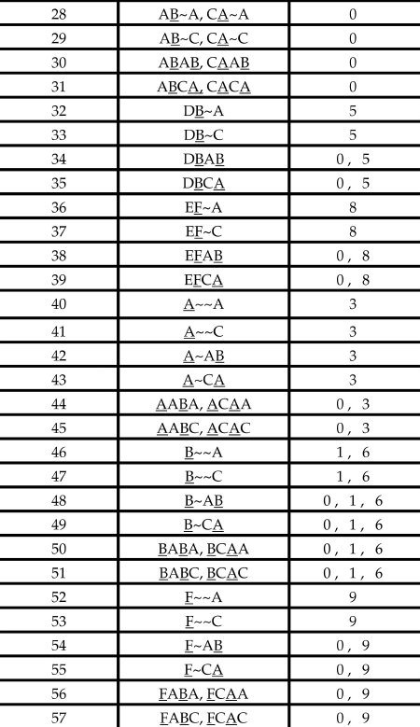
A High-performance bitmap-based architecture
The equivalence classes that form Group 4 are obtained by “intersecting” the equivalence classes of Group 2 with those Group 3
DBAB is derived from DB~~ and ~~AB.
ECID | 4-symbols | F(u)
17 | DB~~ | 5
24 | ~~AB | 0
34 | DBAB | 0, 5
Notes:
有底線代表 accepted state

Slide 47
A High-performance bitmap-based architecture
Group 5 only contains one generalized 4-symbol, and represents the complement of the other groups.
Notes:
有底線代表 accepted state

Slide 48
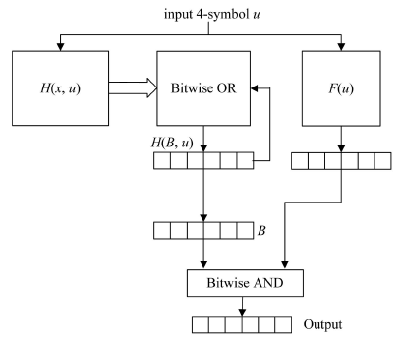
A High-performance bitmap-based architecture
$H\left(x, u\right)= δ^{′}\left(x ,u\right)$𝑓𝑜𝑟 𝑎𝑙𝑙 𝑝𝑎𝑖𝑟𝑠 𝑜𝑓 𝑠𝑡𝑎𝑡𝑒 𝑥 𝑎𝑛𝑑 4−𝑠𝑦𝑚𝑏𝑜𝑙 𝑢.
The initial content of B is set to 1 for the bit representing state and 0 elsewhere.

Slide 49
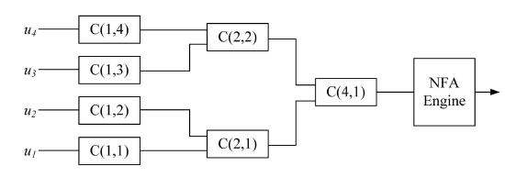
A High-performance bitmap-based architecture
The hierarchical architecture proposed in [5] can be used to find the ECID of an input K-symbol.
Notes:
這篇 Paper 我只有時間大概看一下，大致也是用遞迴的方式暴力找出所有的結果

Slide 50
A High-performance bitmap-based architecture
The length of input string T may not be an integral multiple of K.
Let the length of T be $qK+r, 0≤r≤K−1$. Assume that r>0 and let u=u₁…u_{r} be the last r symbols of T.
A simple solution is to pad (K-r) symbols at the end of u.
Notes:
如果 input T 不是 K 的整數倍怎麼辦？ 那就自己補上
補上不是會產生 false positive 嗎？ 沒關係，因為補上的自己知道。

Slide 51
Some example regular expressions
We study two extended regular expressions selected from Snort.
It is possible to reduce the number of states in a G-NFA if we allow an edge to be labeled with multiple symbols.
Notes:
除了舉例外，再補充一個減少 G-NFA state 數的方式

Slide 52
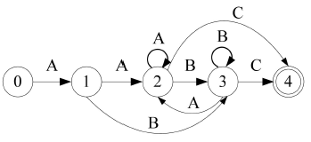
Some example regular expressions
Two states m and n can be merged into one, if
both are final states or both are non-final states.
$m∈Follow\left(RE, x\right) implies n∈Follow\left(RE,x\right)$
$x ∈Follow\left(RE, m\right) implies x∈Follow\left(RE,n\right)$
$n ∈Follow\left(RE, m\right) implies m∈Follow\left(RE,n\right)$

Slide 53
Some example regular expressions
^ : match the beginning of the line.
\s: white space
\x3a: “:”
\x3b: “;”
m: match all line break
i: case insensitive
Considering the case of K =1, there are 11 states in the reduced G-NFA and the set of equivalence classes for input symbols are {[r,R], [c, C], [p, P], [t, T], [o, O], \s, \x3a, [;, \x3b], ~}.
To implement option m, we reset the G-NFA whenever a new line symbol is encountered.
Note that there is at most one active state at any moment, and therefore, the bitwise OR logic can be removed. Also, there is only one final state, which means that the Last bitmap is not needed.

Slide 54
Some example regular expressions
^ : match the beginning of the line.
\s: white space
\x3a: “:”
\x3b: “;”
m: match all line break
i: case insensitive
Hardware resources used in the implementation are two slices, three slice flip flops, four (input) LUTs, and one BRAM. The NFA constructed with the approach proposed in [15] uses 20 slices, four slice flip flops, and 36 LUTs.
For K=4, there are 22 equivalence classes for all the 4-symbols. We used 14 slices, 16 slice flip flops, 25 LUTs, and four BRAMs in the implementation.

Slide 55
Some example regular expressions
The symbol [^\s] represents any symbol, which is not white space.
The option s means that the dot metacharacter includes newline
Notes:
另一個例子其實差不多，之所以要提這個兩例子是為了說明 performance 用的，
因為 RE pattern 不同，差異也很大。

Slide 56
Some example regular expressions
The clock rates for our proposed architectures are slightly larger than that for the logic-based design proposed in [15]. We achieved more than 4 Gbps throughput for both examples with K=4.
With some manipulations, it is possible to reduce the required hardware resources. For example, both the Follow(RE, x) and the Enter(a) tables can be compressed.
One can implement the bound special symbol {69} with a counter. By doing so, the number of states is reduced to 24.

Slide 57
Some example regular expressions
Compared with logic-based designs, our proposed architectures require additional memory but less logic circuit.
One major advantage of our proposed architectures is that they can process data that arrives in small segments, such as packets while logic-based designs cannot.

